Slide 1

Simultaneous Delivery of Chemotherapeutic and Thermal-Optical Agents to Cancer Cells by a Polymeric Nanocarrier
Pinaki C. Dey
Roll: 113300003
Under the guidance of
Dr. Rohit Srivastava
Nov 17, 2011
Indian Institute of Technology Bombay

Slide 2
Cancer
Mutation
Uncontrolled Cell Division
Lack of Contact Inhibition
Angiogenesis
Metastasis
Brain
Retina
Oral
Lung
Liver
Prostate
Breast
Image Sources: www.ncbi.nlm.nih.gov/pubmed, www.wikipedia.org, www.webmd.com, www.images.google.com
Indian Institute of Technology Bombay
Notes:
Cancer… It has turned into a Menace to the Mankind… There are hardly any part of the human body which is out of the purview of this Demon…
From Brain to Blood, from Liver to Lungs, every organ of human body is vulnerable to Cancer…
But, what is this ‘Cancer’…
In layman’s term cancer is the consequence of some significant events in our body which have gone wrong.
More scientifically speaking, it’s the result of some unintended mutation of mainly genes that suppress the tumor and control the cell division.
With the lack of control over cell division, cell grows exponentially with a lack of contact inhibition resulting focal multilayer growth pattern.
In due course of the development they induce angiogenesis and later metastasis, resulting in late stage cancer.
Having said that we must look into the different broad strategies opted for the treatment of cancer…

Slide 3
Chemotherapy
Treatment of cancer with antineoplastic drug(s).
Standardized treatment regimen.
Options are Many…
Problems are Many TOO…
Doxorubicin
(Adriamycin)
Docetaxel
(Taxotere)
Neutropenia
Depigmentation
Swelling, Pain
Skin eruption
Arrhythmias
Cardiomyopathy
Nausea & vomiting
Alopecia
Erythema
Paclitaxel
(Abraxane)
Cisplatin
(Platinol)
Bleomycin
Curcumin
Indian Institute of Technology Bombay
Notes:
One of the intensively used methods to treat cancer is Chemotherapy or simply ‘Chemo’…
It’s nothing but treating cancer with some antineoplastic drugs, of course within prescribed standard regimen.
Options are Many… As you can see over there…
DOX inhibits Topo II
DOC inhibits microtubule disassembly, stabilizes microtubules, induce apoptosis.
PAC works in almost same sort of mechanism.
Cisplatin results DNA-crosslinking, triggering apoptosis.
Bleomycin induce DNA strand breaks.
Curcumin targets cytoplasmic proteins, interfere with NF-kB, induce apoptosis.
But problems are many too… Almost all of these chemotherapeutics drugs have side effects, mainly due to their effect on normal healthy cells.

Slide 4
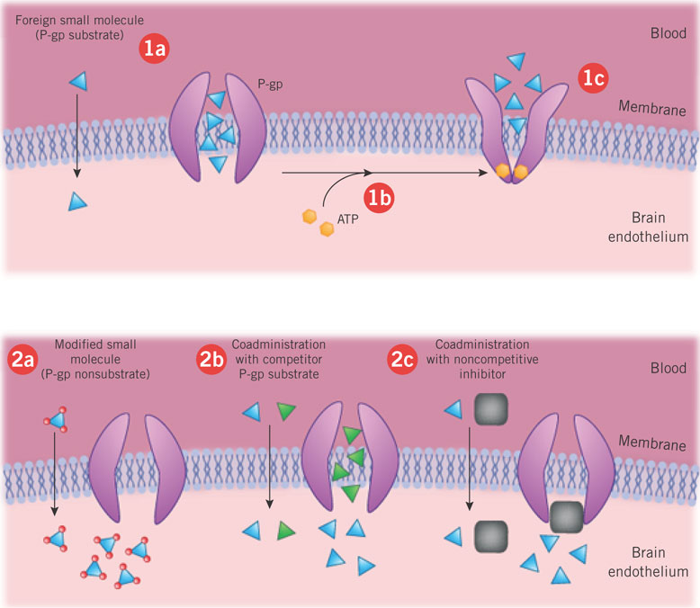
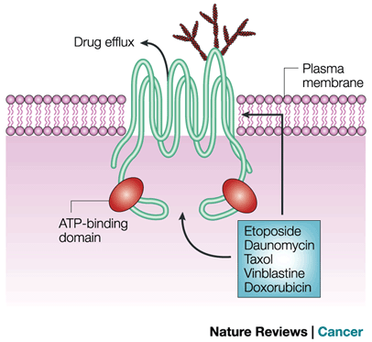
Some Cancer Cells are Resistant to Chemotherapy! Why?
Multiple Drug Resistance (MDR)
Overexpression of ABCB1 gene ➔ Excess P-glycoprotein (P-gp) efflux pump
P-gp on intestinal epithelium, capillary endothelium.
Enzymatic deactivation (Glutathione conjugation).
Decreased Permeability.
Altered Binding Sites.
Indian Institute of Technology Bombay
Notes:
On top of that, we just came to that some cancer cells are resistant to some form of chemotherapy… Only to make our life more miserable!!!
Let’s see why these happen…
Cells become multiple drug resistant due to overexpression of ABCB1 gene which in turn results in excess P-gp efflux pump. As you can see in the figure, they just throw these drugs out, making them worthless.
Enzymatic deactivation of drugs, reduced permeability of cell membrane and altered binding site, all play pivotal role in developing MDR.
So, what now? How would you kill that devil?

Slide 5
Radiotherapy
Ionizing radiation.
Double stranded DNA breaks --- most significant.
Cell Death.
Problems (Again!)
Severely affects nearby healthy cells.
Hypoxic cancer cells are resistant to radiotherapy.
Indian Institute of Technology Bombay
Notes:
So we came up with radiation therapy or radiotherapy.
In this technique basically double-stranded DNA breaks are induced by ionizing radiation.
Remember, Cancer cells have diminished DNA repair ability… So, ultimately they die.
But, even this method is not devoid of drawbacks.
As it affects nearby healthy cells severely and in hypoxic condition cancer cells become resistant to radiation therapy.
[Oxygen is a potent radiosensitizer, increasing the effectiveness of a given dose of radiation by forming DNA-damaging free radicals. Tumor cells in a hypoxic environment may be as much as 2 to 3 times more resistant to radiation damage than those in a normal oxygen environment.]

Slide 6
Hyperthermia
Cancer cell dies above ~43 ºC.
Denaturation and Coagulation of cellular proteins.
Apoptosis and Cell Death.
Used as adjuvant therapy, enhance efficacy of radio/chemo-therapy.
Local/ Regional/ Whole-body Hyperthermia.
Can we apply targeted hyperthermia, without affecting healthy cells?
Increase blood flow, perfusion, O₂ delivery.
Indian Institute of Technology Bombay
Notes:
Cancerous cells are not inherently more susceptible to the effects of heat.^{[2]} When compared in in vitro studies, normal cells and cancer cells show the same responses to heat. However, the vascular disorganization of a solid tumor results in an unfavorable microenvironment inside tumors. Consequently, the tumor cells are already stressed by low oxygen, higher than normal acid concentrations, and insufficient nutrients, and are thus significantly less able to tolerate the added stress of heat than a healthy cell in normal tissue.

Slide 7
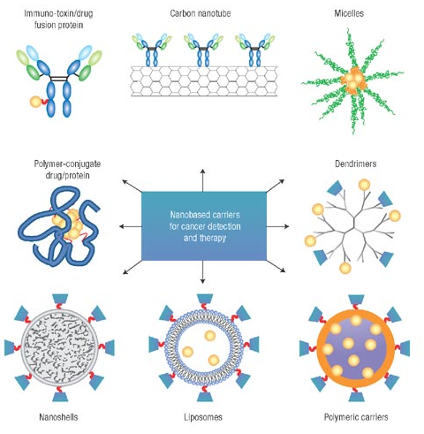
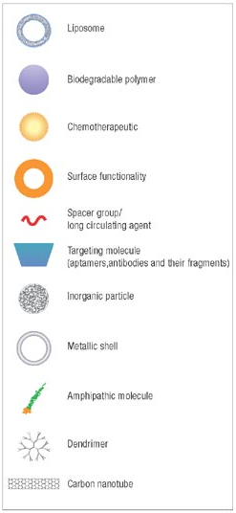
Nanocarriers & Drug Delivery
Size or Dia: ~50-150 nm
High S/V ratio
Biocompatible
Biomimetic
Better conduction
Optical property
Overcome barriers
(pH, RES, P-gp)
Targeted delivery
Controlled release
Reduced toxicity
Bio-degeneracy
Take adv. of EPR effect
Image source: www.nature.com
Indian Institute of Technology Bombay

Slide 8
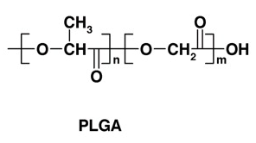
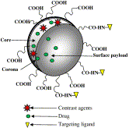
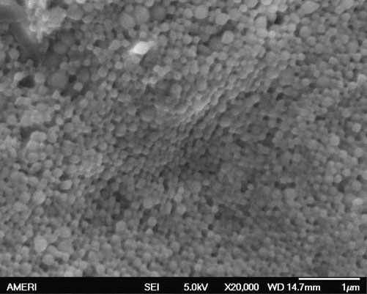
Polymeric (PLGA) Nanocarrier
Poly(DL-lactide-co-glycolide)
Biocompatible + Biodegradable + FDA √
Hydrophilic + Hydrophobic Load
Controlled Release Kinetics (PLA:PGA)
Size: ~100 nm Diameter
Less plasma protein adsorption
Internalized by endocytotic process
Surface Conjugation
Bio-elimination
Diagnostic, Imaging & Delivery
Source: http://www.pnas.org
Source: Acharya et al, 2011
Source: Tang et al, 2010
Indian Institute of Technology Bombay

Slide 9
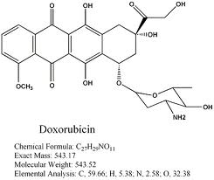
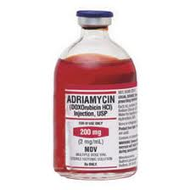
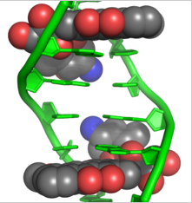
ICG-DOX-PLGA-NPs
Anthracyclin antibiotic
Hydrophobic
Intercalates with DNA at minor groove
Inhibits topoisomerase II activity
Cease Replication
Fluorescent
DOX (Doxorubicin)
Source: chem257.pbworks.com
ADRIAMYCIN
Source: mcguffmedical.com
DOX-DNA INTERACTION Source: PDB 1D12
Indian Institute of Technology Bombay

Slide 10
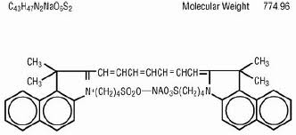
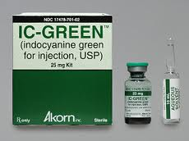
ICG-DOX-PLGA-NPs
FDA approved
Cyanine dye
Binds to plasma protein
Half life: ~3 min, rapid plasma clearance
Poor stability
Fluorescent, absorbs NIR (808 nm)
ICG (Indocyanine Green)
Organic, biocompatible, biodegradable
Can be delivered in high concentration by NPs
Source: rxlist.com
Source: fdb.rxlist.com
Indian Institute of Technology Bombay

Slide 11
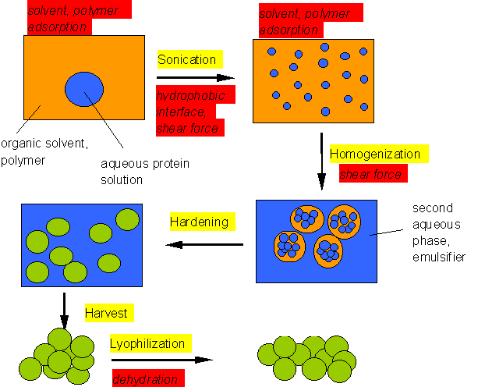
ICG-DOX-PLGA-NPs
O/w emulsion solvent evaporation method
Preparation
Factors controlling particle size & entrapment
PLGA concentration PVA concentration Initial drug (DOX, ICG) content
Dispersed Organic Phase
PLGA (60 mg)
ICG (1 mg)
Continuous Aqueous Phase
PVA solution (stabilizer) (3% w/v)
Emulsification with sonication (50W, 1 min)
Rapid Evaporation of organic mixture under reduced pressure
Ultracentrifuge (14k rpm, 30 min)
DOX (1 mg)
Methanol-Dichloromethane (4 ml) (1:3 v/v)
Repeat 3 times
Washing with DW
Lyophilization
ICG-DOX-PLGA-NPs
Dissolve in
Source: www.ijvs.com
Indian Institute of Technology Bombay

Slide 12
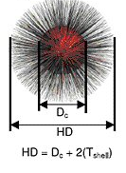
ICG-DOX-PLGA-NPs
Characterization
Hydrodynamic diameter [~135 nm]
Dynamic Light Scattering (DLS)
Uniformity of NP shape & size [90 nm]
Scanning Electron Microscopy (SEM)
Zeta Potential (Dispersion stability)
Zetasizer
Spectrofluorometric Analysis DOX: 496 nm/ 592 nm ICG: 775 nm/ 845 nm
ICG-DOX Entrapment Efficiency
Cell Proliferation & Cytotoxicity
SRB assay (colorimetric measurement of cellular protein)
Hydrodynamic diameter
Source: cfpub.epa.gov
Indian Institute of Technology Bombay

Slide 13
Effect of PLGA concentration on particle size and zeta potential
Organic Phase
Increased PLGA conc.
Emulsion
Increased viscosity
Absorption of agitation energy
Reduction in shear force
Larger NP size
Decrease in Zeta Potential
(Source: R. Manchanda et al, 2010)
Indian Institute of Technology Bombay

Slide 14
Effect of PLGA concentration on entrapment efficiency
Organic Phase
Increased PLGA conc.
Increased viscosity
Organic to Aqueous Phase
Increased diffusion resistance
Due to Larger NP size
Organic Phase
Increased length of Diffusional pathway
(Source: R. Manchanda et al, 2010)
Indian Institute of Technology Bombay

Slide 15
Effect of PVA concentration on particle size and zeta potential
Aqueous Phase
Increased PVA conc.
Interfacial area
More PVA orientation Reduced interfacial tension
Emulsification
Increased Net Shear Stress
Smaller NP size
Increase in Zeta Potential due to more coating layer
(Source: R. Manchanda et al, 2010)
Indian Institute of Technology Bombay

Slide 16
Effect of PVA concentration on entrapment efficiency
Aqueous Phase
Increased PVA conc.
Smaller NP size
Reduced entrapment efficiency
During Emulsification
More molecules of drugs partition out rapidly.
(Source: R. Manchanda et al, 2010)
Indian Institute of Technology Bombay

Slide 17
Release kinetics of DOX and ICG
Biphasic pattern
Initial burst release
Diffusion-initiated release
ICG release faster
Incomplete release of both drugs
ICG Release
DOX Release
(Source: R. Manchanda et al, 2010)
Indian Institute of Technology Bombay
Notes:
The cumulative release of both the drugs remains incomplete due to short time duration of study (48 hours here) as well as the increased initial drug content. Increases in initial drug content result in increased polymer–drug interactions, which make the nanoparticle matrix more rigid, and cause incomplete and slower release of drugs from the nanoparticle.
The hydrophilic ICG molecule shows faster release profile compared to hydrophobic DOX.

Slide 18
Cellular uptake and Sub-cellular localization of DOX
Subcellular localization of DOX and ICG in Dx5 cells. a) DOX fluorescence of ICG-DOX; b) ICG fluorescence of ICG-DOX; c) merged picture of a & b; d) DOX fluorescence of ICG-DOX-PLGANPs; e) ICG fluorescence of ICG-DOX-PLGANPs; f) merged picture of d & e. (Tang et al, 2010)
Indian Institute of Technology Bombay
Notes:
The increase in intracellular uptake of DOX is mainly because of the endocytosis of PLGA NPs which helps NPs to escape P-gp pump efflux mechanism and lead to delivery of significant amount of DOX compared to free DOX, which is internalized into cell mainly by diffusion. Cationic surface charge of surface-modified NPs can increase the cellular uptake level significantly due to increased rate of internalization.
NP encapsulation does not increases fluorescence intensity of ICG inside the cells when compared to its free form delivery. This is because ICG is not involved in MDR mechanism and hence NP encapsulation should not increase its uptake.

Slide 19
Cytotoxicity of ICG-DOX-PLGA-NPs
Cytotoxicity of ICG-DOX-PLGANPs when excited by NIR laser. ICG-DOX-PLGA-NP concentration 0.25 mg/ml, which contains 10 μM DOX and 6.2 μM ICG. Verapamil (5 μg/ml) is a calcium channel blocker, inhibits energy dependent active transport and activity of P-gp efflux pump. SKOV-3: less sensitive to DOX (p53 mutation), MES-SA: DOX sensitive, Dx5: DOX resistant (overexpresses P-gp) (Tang et al, 2010)
Indian Institute of Technology Bombay

Slide 20
Temperature profile during hyperthermia treatment
NIR laser – ICG hyperthermia
Temperature profile during hyperthermia treatment. (a) Temperature generation under the action of NIR laser, as a function of ICG concentration. (b) Temperature elevation profile during 43 ºC incubator hyperthermia. (Tang et al, 2009)
Indian Institute of Technology Bombay

Slide 21
Effect of ICG without DOX
Net growth vs. ICG concentrations. Cytotoxicity can be observed at high concentration of ICG as in 100 µM. Significant increase in cytotoxicity can be observed due to the administration of NIR-laser. (Tang et al, 2009)
Indian Institute of Technology Bombay

Slide 22
Effect of DOX with non-laser/incubator treatment
DOX concentration vs. Net Growth for incubator hyperthermia. Observe the subadditive effect in non-laser/incubator hyperthermia. (Tang et al, 2009)
Indian Institute of Technology Bombay

Slide 23
Effect of DOX with ICG and laser treatment
Net growth vs. DOX concentrations. For ‘‘DOX + 5 lm ICG + 1 min laser” group, zero DOX concentration indicated the effect of laser-ICG hyperthermia alone. Dotted line indicates the predicted additive effect of combining DOX chemotherapy with laser-ICG hyperthermia. The combinational treatment showed synergistic effect. (Tang et al, 2009)
Indian Institute of Technology Bombay

Slide 24
Comparison between the combinational treatments
Comparison between the combinational treatments. (Tang et al, 2009)
Indian Institute of Technology Bombay

Slide 25
Conclusion
Combinational treatment using ICG-DOX-PLGANPs prominently effective on DOX resistant MDR cancer cells.
Hyperthermia --- a good adjuvant therapy, enhance efficacy and reduce dosage of ‘Chemo’.
Synergistic effect may exist when combining laser-ICG hyperthermia with DOX.
Indian Institute of Technology Bombay

Slide 26
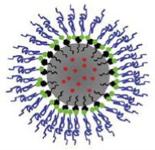
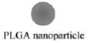
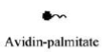

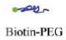
Future Prospect
Challenges
Surface conjugation (PEGylation, Avidin-Biotin)
Active targeting (VEGFR-2, HER-2 Folate, Transferrin, mAb, RNA Apt)
Focus on Lung/Breast/Prostate cancer
Lack of literature on the comparative studies on the following:
Doxorubicin vs. Docetaxel
Target based efficacy of drugs
Methods of P-gp inhibition
Interaction between ICG & DOX at molecular level
Indian Institute of Technology Bombay

Slide 27
Reference
Y. Tang et al., “Simultaneous delivery of chemotherapeutic and thermal-optical agents to cancer cells by a polymeric (PLGA) nanocarrier: an in vitro study.,” Pharmaceutical research, vol. 27, no. 10, pp. 2242-53, Oct. 2010.
R. Manchanda, A. Fernandez-Fernandez, A. Nagesetti, and A. J. McGoron, “Preparation and characterization of a polymeric (PLGA) nanoparticulate drug delivery system with simultaneous incorporation of chemotherapeutic and thermo-optical agents.,” Colloids and surfaces. B, Biointerfaces, vol. 75, no. 1, pp. 260-7, Jan. 2010.
Y. Tang and A. J. McGoron, “Combined effects of laser-ICG photothermotherapy and doxorubicin chemotherapy on ovarian cancer cells.,” Journal of photochemistry and photobiology. B, Biology, vol. 97, no. 3, pp. 138-44, Dec. 2009.
H. Park, J. Yang, J. Lee, S. Haam, I.-H. Choi, and K.-H. Yoo, “Multifunctional nanoparticles for combined doxorubicin and photothermal treatments.,” ACS nano, vol. 3, no. 10, pp. 2919-26, Oct. 2009.
J. Park et al., “PEGylated PLGA nanoparticles for the improved delivery of doxorubicin.,” Nanomedicine : nanotechnology, biology, and medicine, vol. 5, no. 4, pp. 410-8, Dec. 2009.
J. D. Byrne, T. Betancourt, and L. Brannon-Peppas, “Active targeting schemes for nanoparticle systems in cancer therapeutics.,” Advanced drug delivery reviews, vol. 60, no. 15, pp. 1615-26, Dec. 2008.
S. Acharya and S. K. Sahoo, “PLGA nanoparticles containing various anticancer agents and tumour delivery by EPR effect.,” Advanced drug delivery reviews, vol. 63, no. 3, pp. 170-83, Mar. 2011.
J. Park, T. Mattessich, S. M. Jay, A. Agawu, W. M. Saltzman, and T. M. Fahmy, “Enhancement of surface ligand display on PLGA nanoparticles with amphiphilic ligand conjugates.,” Journal of controlled release : official journal of the Controlled Release Society, Jun. 2011.
Indian Institute of Technology Bombay

Slide 28
Thank You …
Indian Institute of Technology Bombay

